Slide 1
DO YOU DARE TO SHOW YOUR TRUE COLOURS?
Anas & Rachelle

Slide 2
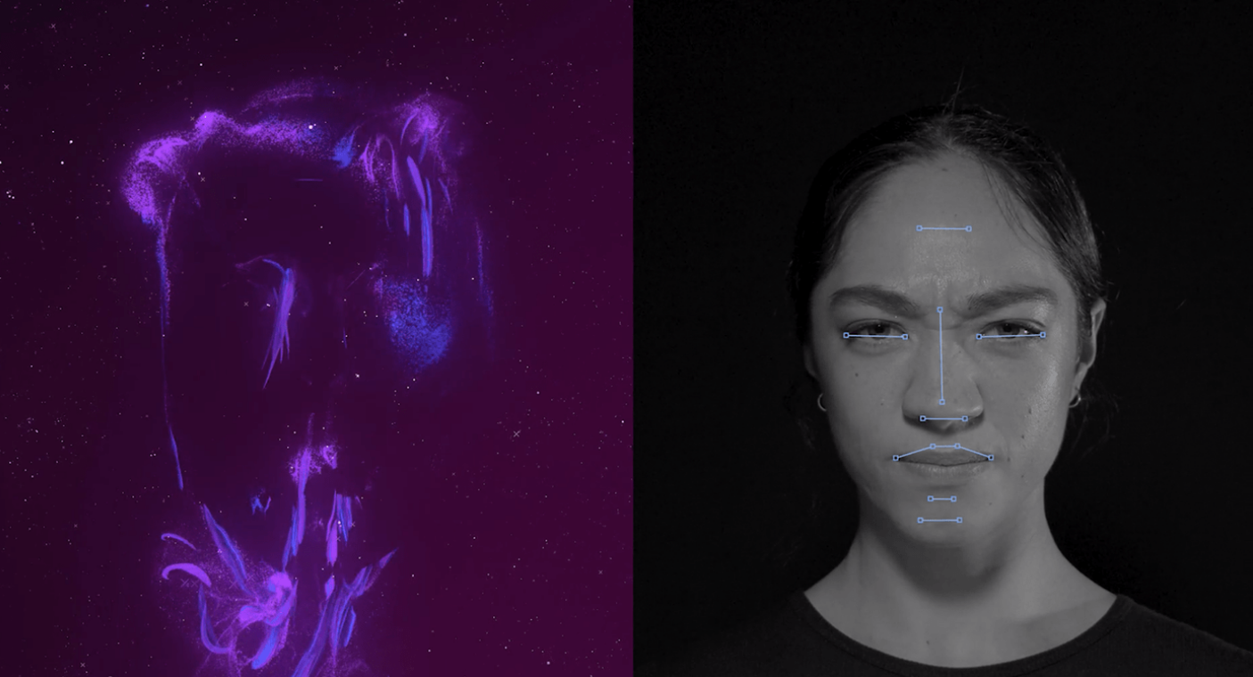
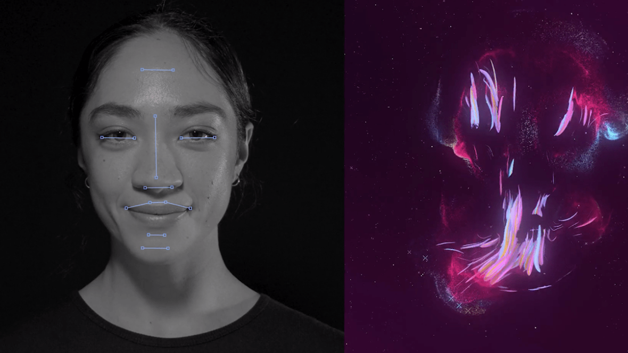
The idea

Slide 3
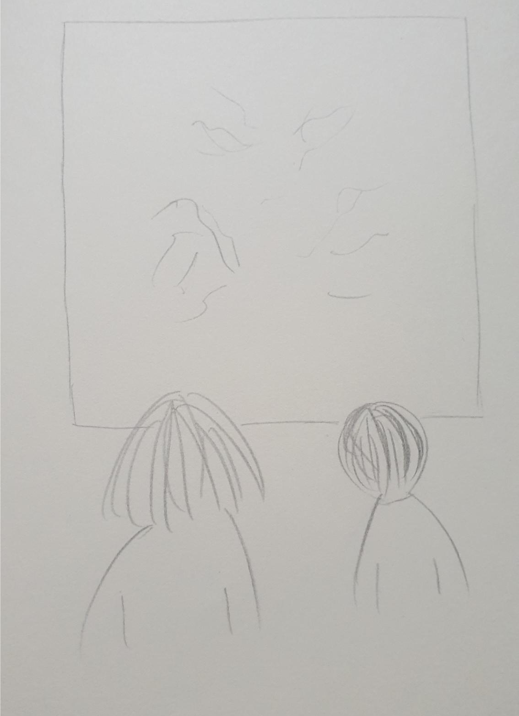
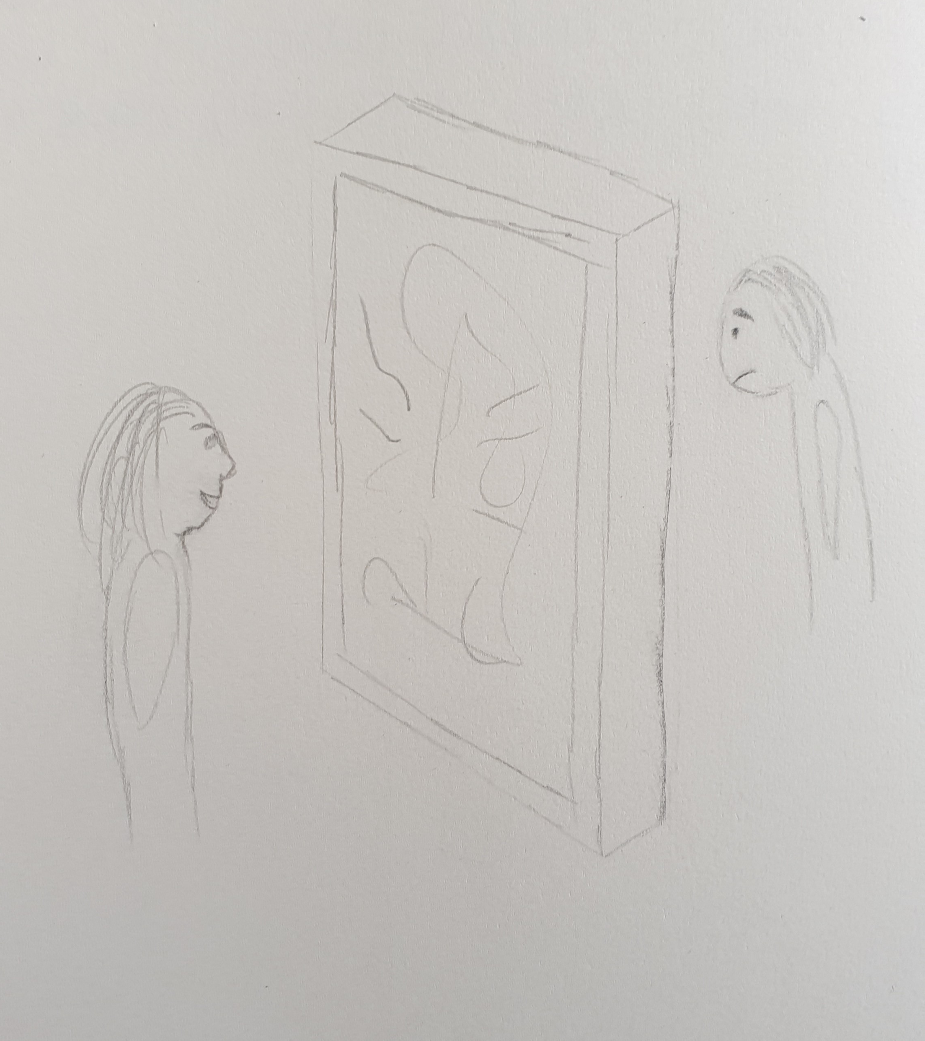

Slide 4
Planning
Experiment
Visualization
Sound
Lo-Fi prototype
Hi-Fi prototype

